Slide 1
Sport Squear
citylink 2017
project
By Ilja Magdenko and Daniyar Karimullinov

Slide 2
SPORT Square
PROPOSAL
H\V BARS • OUTDOOR EQUIPMENT • BENCHES • STREET SPORTS
Also, sport grounds can develop
speed, strength, endurance and
agility that will help to extend life
duration and keep body fit.
Moreover, for new-come students,
tourists or unconfident people
sport is the option to find friends,
become more confident and
socialized, or even rally a team.
Besides, when individual takes a
part in certain sport on sport
grounds, it is an opportunity to join
a big sport.[Likewise, there will be
equipment that can be easily
installed and removed, this is an
innovation to attract people to do
some activities.
When people spend their time on the sport ground, it is an efficient way to lead a healthy lifestyle and reduce or give up habits that cause harm on human body.

Slide 3
SPORT Square
SCOPES
MOST IMPORTANT PROJECT SCOPES
1
Health
Socializing
3
Body fit
Road to big sport
5
Discipline
Activity
2
4
6

Slide 4
PROJECT
BUDGET
CITY COUNCIL • SPORT BRANDS • UNIVERSITIES CLUBS • LOCAL STORT SHOPS
Council can show care of people performing such events as most of people will have strong immune system, more daily activity work and more adolescents will go into sport.
Sport brands such as Adidas, Nike, Everlast and etc. can invest into sport events and this will bring profits to sport companies as people use sport equipment.
Uni societies can compete not only with each other, but with regular people who does sport activities.
Local shops can sponsor events and it will bring profits to them.
Price | Pull Up bars | Horizontal Bars | Sports Staircase | Coating | Extra Stuff
Big Square | 4 REQ - 250£ | 2 REQ - 120£ | 2 REQ - 200£ | BIG - 250£ | 4-8 - 1000£
Small Square | 2 REQ - 170£ | 1 REQ - 60£ | 1 REQ - 100£ | Small - 200£ | 2-3 - 150£
 |  |  |  | Max. Total | Big - 2020£
 |  |  |  |  | Small - 680£

Slide 5




Why sport is great idea?
Why does a person need to move?
City council • sport brands • universities clubs • healf
The most important reason for doing sports is the need to strengthen health, strengthen the heart, and control blood pressure. Exercises performed regularly, promote the resolution of potentially dangerous blood clots in the blood, slow the aging process.
Sports exercises tonify muscles, make them strong and hardy. They become more elastic, and you are smart, attractive, sexy and flexible. Your joints acquire a large amplitude of movements. Exercise helps to achieve the ideal weight and maintain it, which can not be achieved only by diet.
Thanks to sports exercises, you can control your appetite, because the amount of endorphins increases. They protect the body from a feeling of hunger until it really does not need "recharging".
Sports activities help to withstand chronic fatigue, increasing the supply of vitality, increasing the level of energy of your body. They give an extra supply of oxygen to the brain and make you more energetic throughout the day.

Slide 6
Places for
Sport square
Parks are the easy-accessible places for creating
sport square, as many people walk in the park. If
parks are provided with sport equipment, it will
increase people doing activities.
Also, one of the best option is to provide schools
with sport equipment outside, e.g. during the
break pupils can relax and express all the
redundant energy on workout installation.

Slide 7
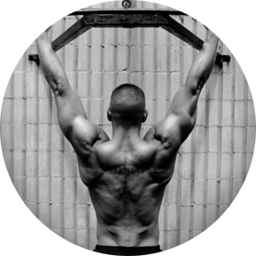
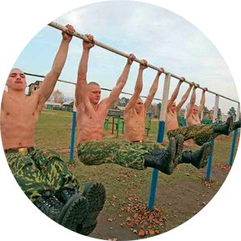
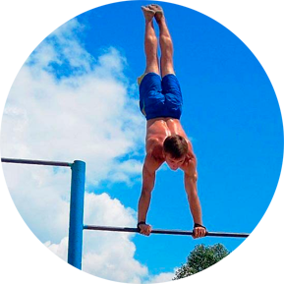
Sport Square
for man

Slide 8
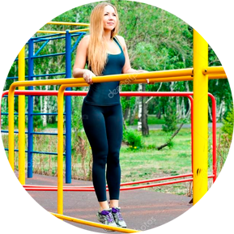
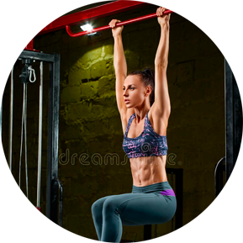
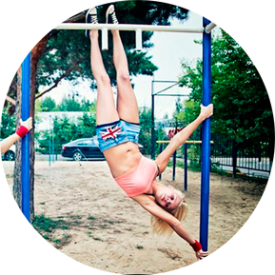
Sport Square
For woman

Slide 9
SWOT
Strength
Weakness
Opportunity
Threat
Increase of people doing sports, attraction of adolescents to start doing sport instead of bad habits e.g. smoking and drinking
Increase of the amount of people that can participate in bigger events and development of communication among participants
Weather is very unstable condition that will frighten or delay the sport activities
For people who has never done sport before starting sport will be a challenge

Slide 10
Sport square
legality
The project can be implemented if the sport square project is not contradicting to other city council projects.

Slide 11
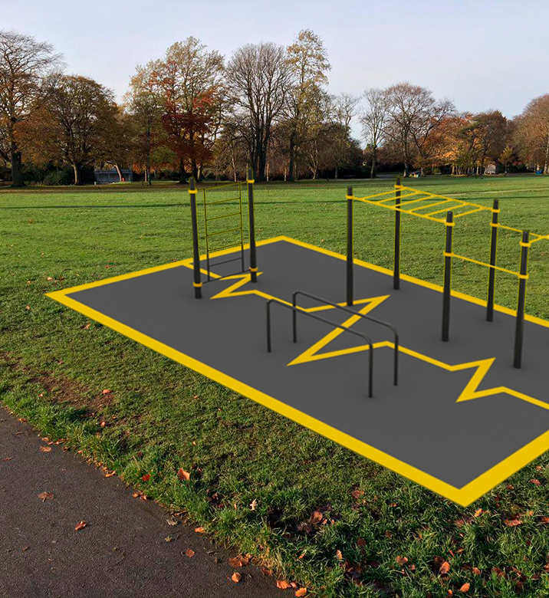
square
surface
For building sport square, it is need to
provide specific safety surfacing to
decrease or avoid the damage if person
falls. Also, the quality of the equipment
will impact on safety of sport ground.

Slide 12
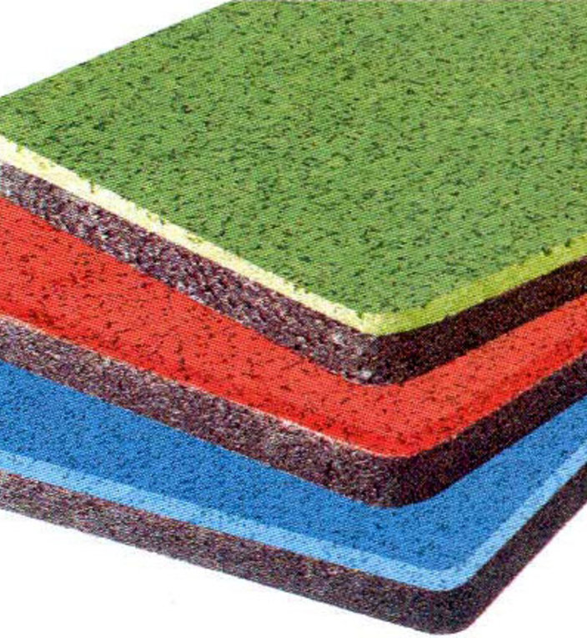
Surface
Type
Rubber coating for sports grounds.
It is made on the basis of rubber crumb, the finishing surface is applied to the prepared leveled base from asphalt, concrete or compacted multilayer soil. This option is used for professional playgrounds, as well as for various training facilities, for example, for school stadiums.

Slide 13
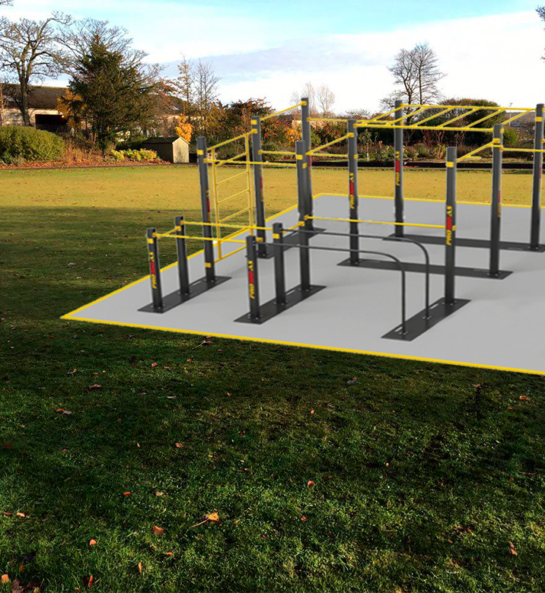
square
small
Small sport square for 1-6 persons.
(Can be in parks, yards and so on)

Slide 14
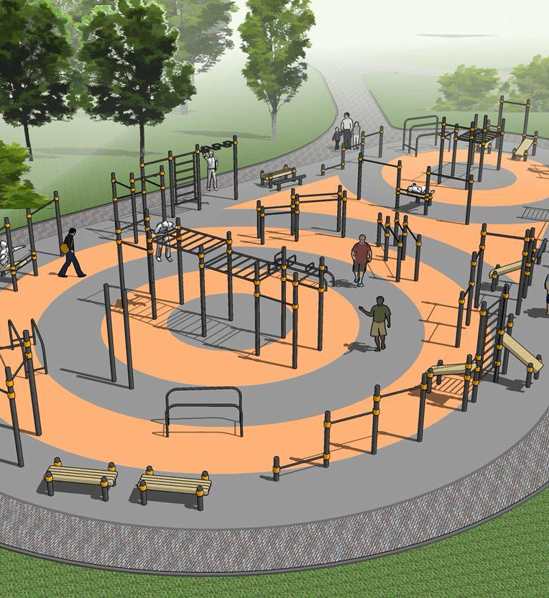
square
BIG
Massive sport square for people.

Slide 15

Square
app
ANDROID AND IOS
Square app can be created and provided to Android and IOS
users. The main aim of the app will exercise instruction with
explanation or video tutorial, and users can communicate with
each other. Also, users will be able to arrange meeting and
gather into groups for specific time and exercises.

Slide 16
App
functions

Slide 17

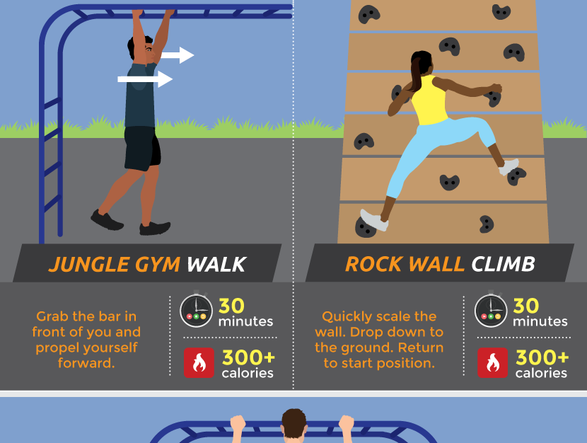
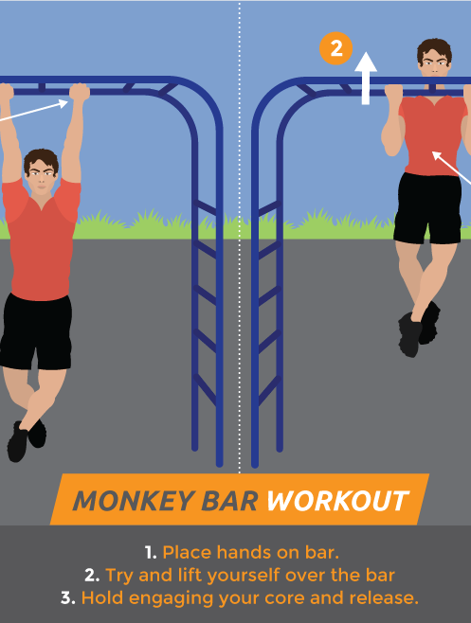
Sport Square
instructions

Slide 18

Social networks
Facebook groups
Instagram page
Google+ page
Twitter
And so on.

Slide 19
sport
Interest
2018
2019
Our project can increase attraction and interest of doing sport among people and youth. This will be an innovation in cultural side.

Slide 20
thanks for
listening

